Slide 1
Scaling Strategies: Horizontal, Vertical & Diagonal
Scalability In System Design

Slide 2
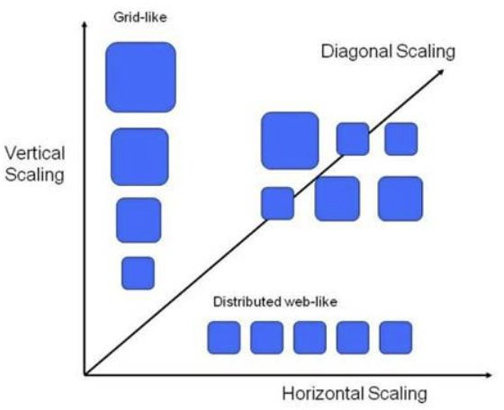
Quick Recap – Types of Scalability
Vertical: Upgrade one machine
Horizontal: Add more machines
Diagonal: Start vertical, then go horizontal

Slide 3
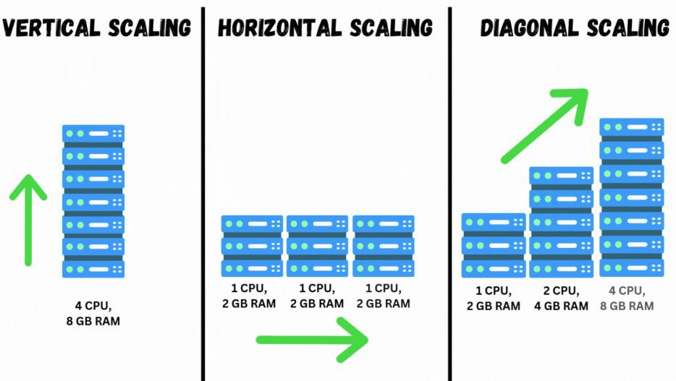
Types of Scalability - Deep Dive
Vertical: Upgrade one machine
  Upgrade server’s CPU, RAM, Disk
  Easy to implement (less complexity)
  Limits: Physical cap, risk of single point of failure
Horizontal: Add more machines
  Add more nodes to distribute traﬃc/load
  Requires load balancer, stateless design
  Complex setup (coordination, replication)
Diagonal: Start vertical, then go horizontal
  Hybrid approach: start vertical, add horizontal as needed
  Common in cloud-native apps
  Cost-eﬀective + long-term ready

Slide 4
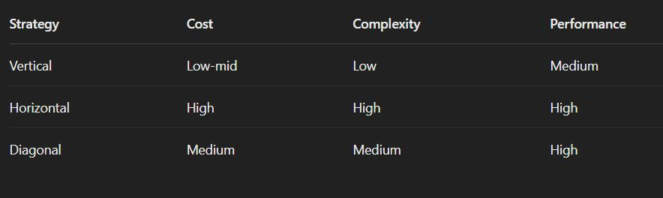
Trade-Offs: Cost vs Complexity vs Performance

Slide 5
Real-World Examples and When to Choose What?
Examples:
  Twitter: Moved from monolith → horizontal scaling (microservices)
  Small startups: Vertical scaling for MVP
  AWS Lambda apps: Start diagonal with autoscaling
When to choose:
  Startups: vertical (cheaper, simpler)
  Scaling apps: horizontal (resilience + capacity)
  Cloud-native: diagonal (ﬂexibility + cost balance)

Slide 6
Interview Questions - Scaling Strategies
What is the diﬀerence between horizontal and vertical scaling?
What is diagonal scaling and when is it a good idea?
What are the trade-oﬀs between horizontal and vertical scaling in terms of performance and complexity?
Can you describe a scenario where horizontal scaling wouldn’t help?
When would you choose vertical scaling over horizontal?
What challenges arise in horizontal scaling and how would you solve them?

Slide 7
Summary & What’s Next
Scaling Strategies:
  Vertical = simpler, but hits limits
  Horizontal = scalable, but needs planning
  Diagonal = hybrid approach for cloud success
What’s next:
  Understanding Load Balancers: Types, Algorithms & Cloud Solutions

